Slide 1
ConsulAI Project Mid-week check point
Deloitte Hackathon Team3

Slide 2

Project Vision
AI-Powered Analyst Assistant for BC Post-Secondary Education
--To create an intelligent assistant that empowers analysts in the British Columbia higher education sector to rapidly gather insights, monitor institutional strategies, and respond to opportunities with precision — using the combined power of autonomous agents, strategic frameworks, and human-in-the-loop validation.

Slide 3
Project Highlight
Agentic Research Excellence: Utilize advanced autonomous agents to streamline and execute the research process, drastically reducing manual effort and speeding up data collection and preliminary analysis.
Human-in-the-Loop Quality Control: Integrate expert oversight at key stages to ensure data accuracy and high-quality research outcomes, blending the efficiency of automation with the nuanced judgment of seasoned professionals.
Strategic Framework Integration: Embed established consulting methodologies and strategy frameworks directly into the system, arming the agent with the structured thinking needed to deliver sound, strategic recommendations.
RAG-Powered Knowledge Base: Leverage Retrieval Augmented Generation (RAG) technology to build a dynamic, project-specific knowledge base, ensuring that insights are both contextually relevant and constantly updated.

Slide 4
Technical Feasibility
Agentic System
LangChain ,LangGraph
Language Model Integration
OpenRouter
Data Processing & Analysis
ConsulAI
Numpy, Pandas,
Prompt Engineering,
Qdrant, vectorize
Browser Interaction
Browser_use

Slide 5
Project Milestone
Brainstorm/Project Scope
March 24th 2025
Presentation/Product Development
March 26th 2025
Development Finish
March 27th 2025
Coaching/Prototyping
March 25th 2025
Presentation Day March 28th 2025, 1 - 3 PM

Slide 6
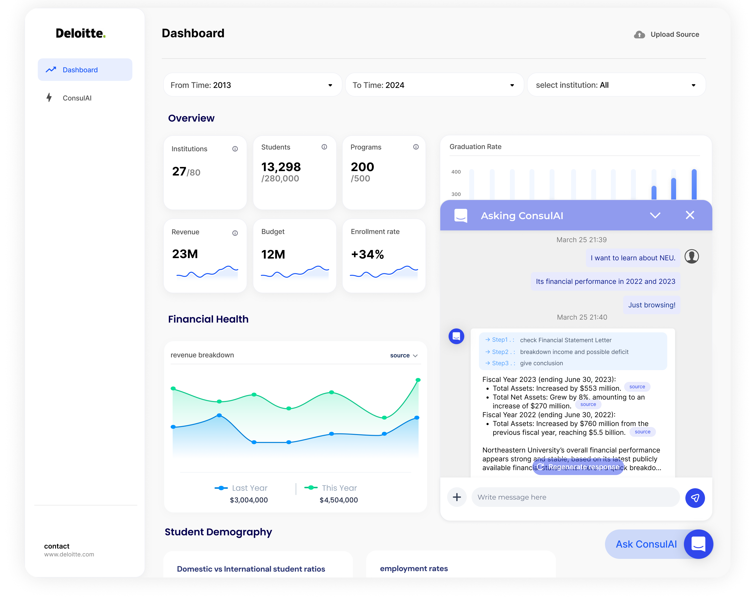
Product Concept Demo

Slide 7
Thanks for watching!

